Slide 1
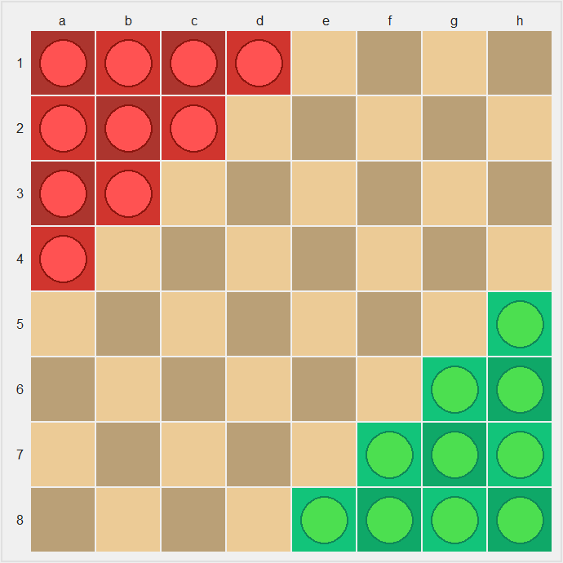
Halma
CS181 Final Project
熊章智，杨天倪，冯令康

Slide 2
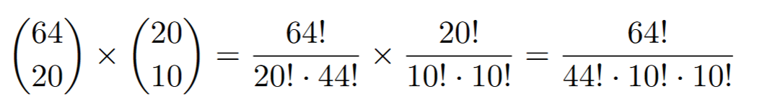
Setting
8*8 grids
20 pawns in total (10 per side)
Around 10²⁸ States!

Slide 3
Implement methods
Human Player
Random
Greedy
Minimax (alpha-beta pruning)
MCTS
(Conventional) Approximate Q-learning
Neural Approximate Q-learning

Slide 4
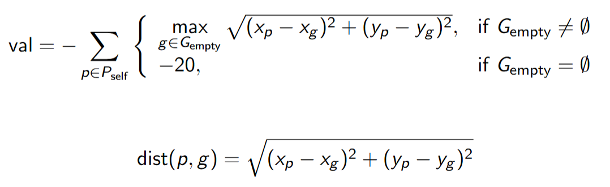
State Evaluation
Calculate the Euclidean distance from the pawn to every empty or non-player-occupied position in the player's goal area.
If there are available goal positions, add the maximum of these distances to a running total (val).
If there are no available goal positions for that pawn, subtract 20 from the total as a penalty.
After evaluating all pawns: Multiply the total score by -1, so that a smaller distance (i.e., pawns closer to the goal) results in a higher evaluation score.

Slide 5
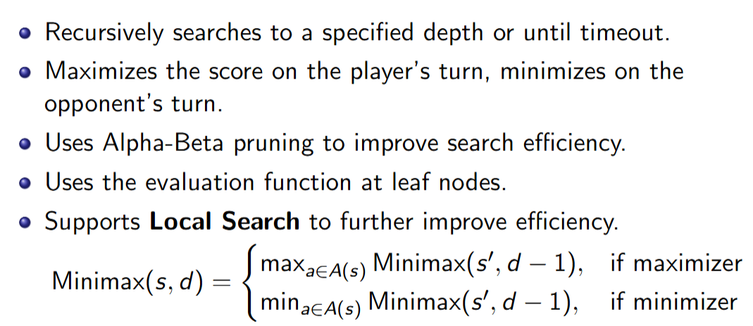
Basic Methods
Random & Greedy
Minimax with alpha-beta pruning:

Slide 6
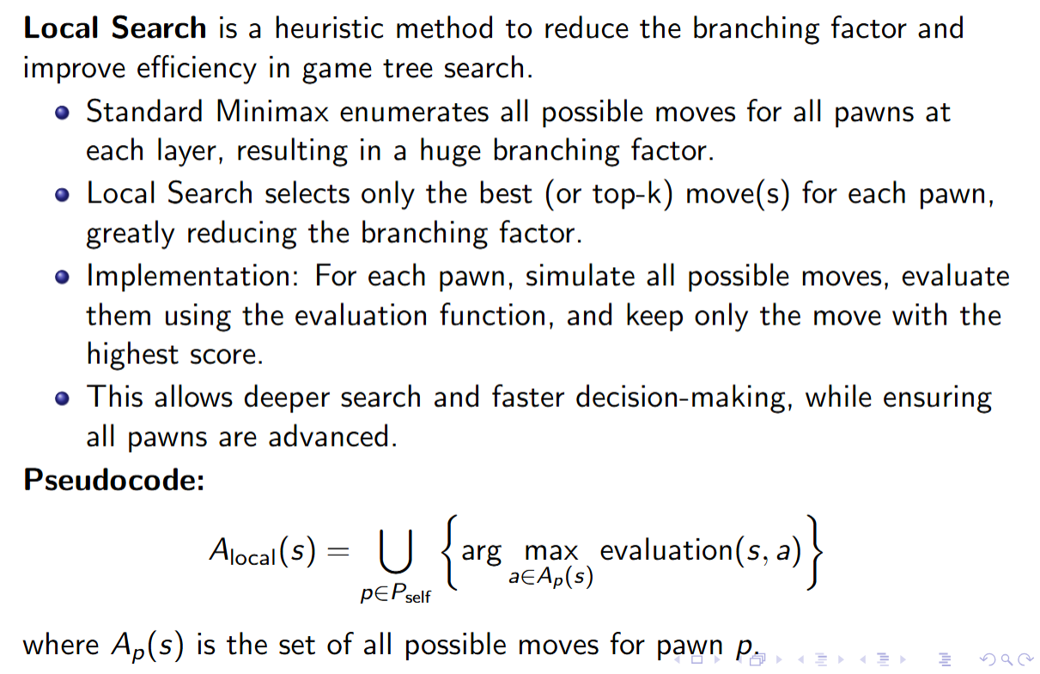
Minimax with Local Search Skill

Slide 7
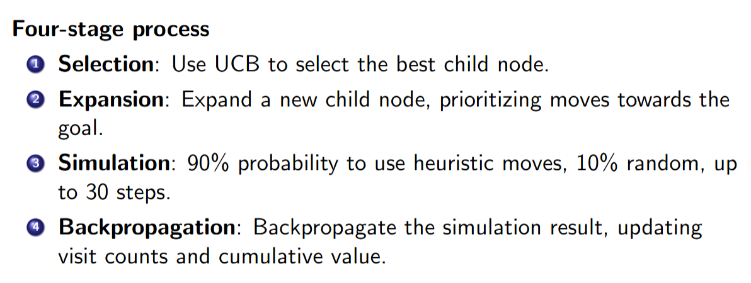
MCTS

Slide 8
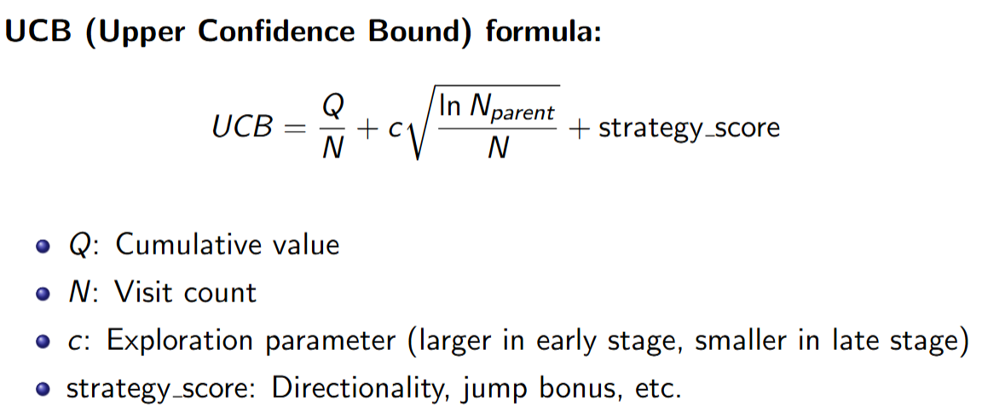
MCTS

Slide 9
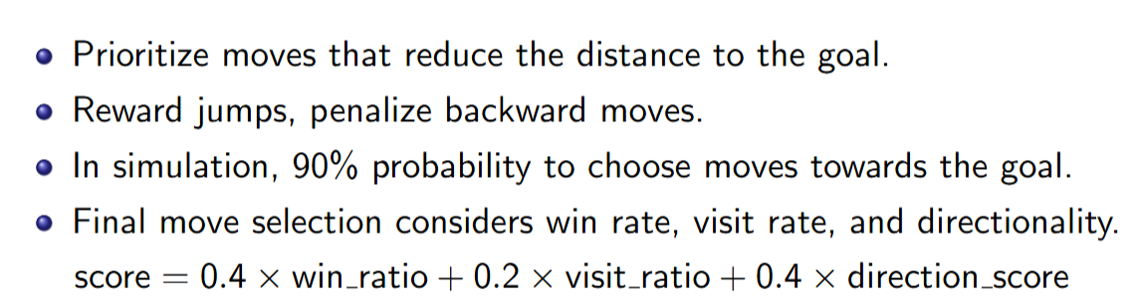

Slide 10
Q-learning
Unfortunately, we failed to train a Q-learning agent...
First of all, (s, a) pairs are numerous. The file containing trained parameters after 200 episodes is 21GB!
Secondly, it is hard to train. We tried letting Q-learning to fight against random/minimax/Q-learning agents, but failed.

Slide 11
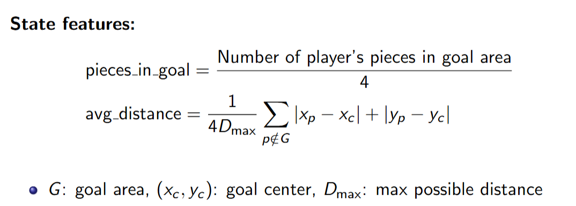
Approximate Q-learning

Slide 12
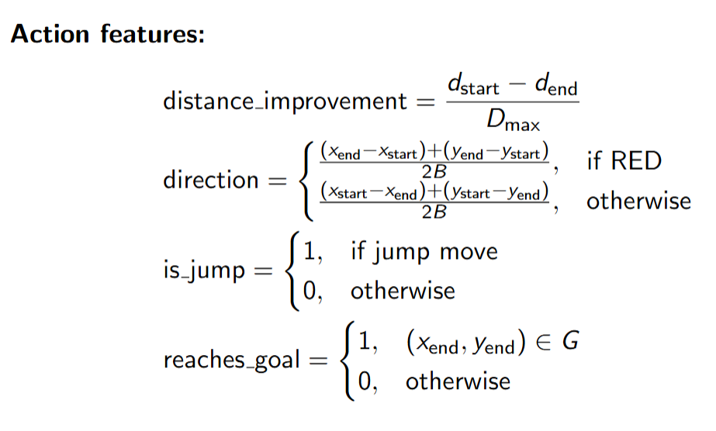
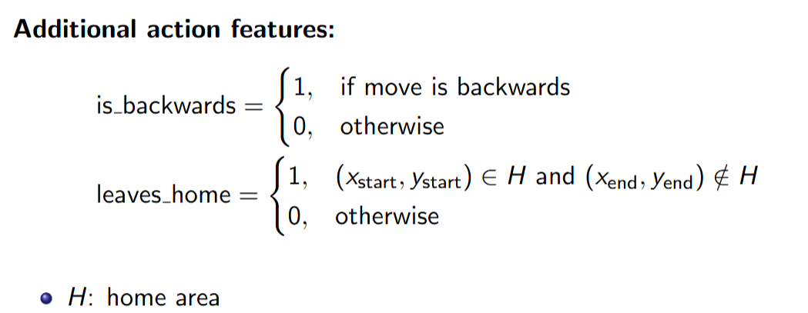

Slide 13
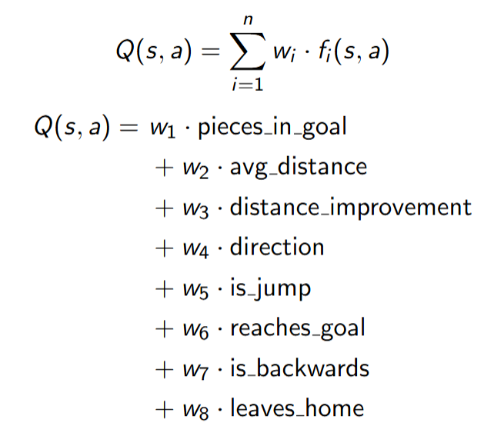

Slide 14
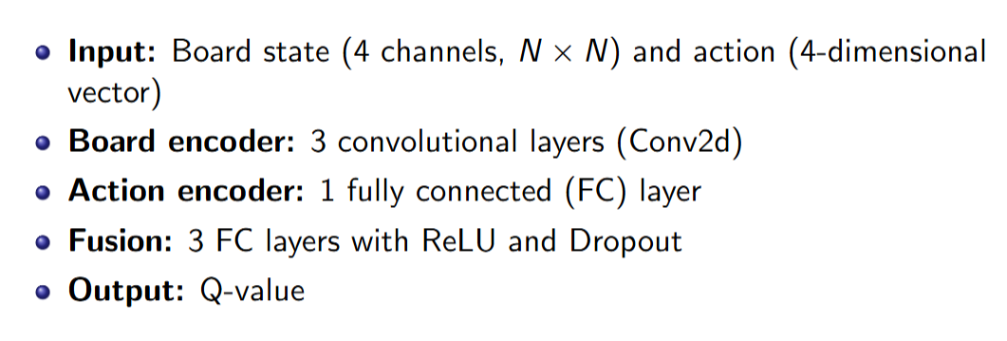
Neural Approximate Q-learning: Network Architecture

Slide 15
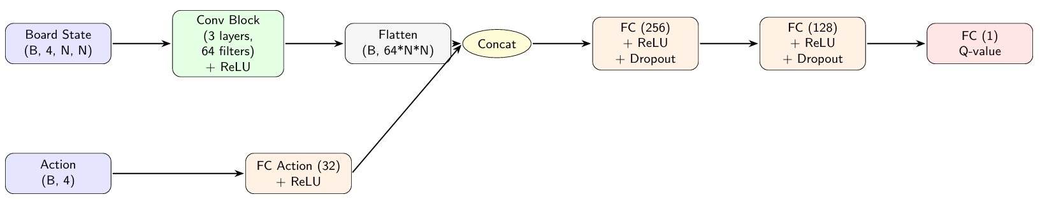
Diagram

Slide 16
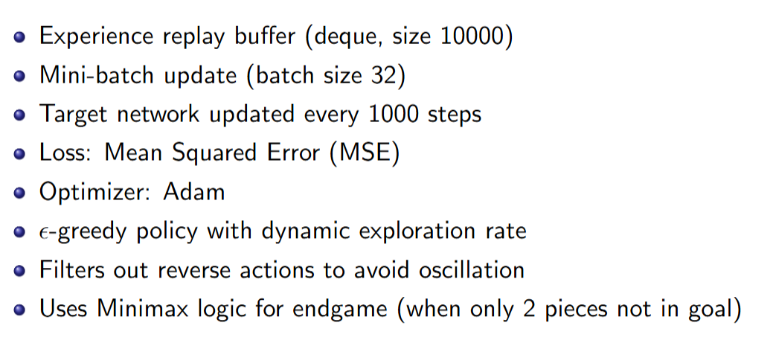
Training Detail

Slide 17
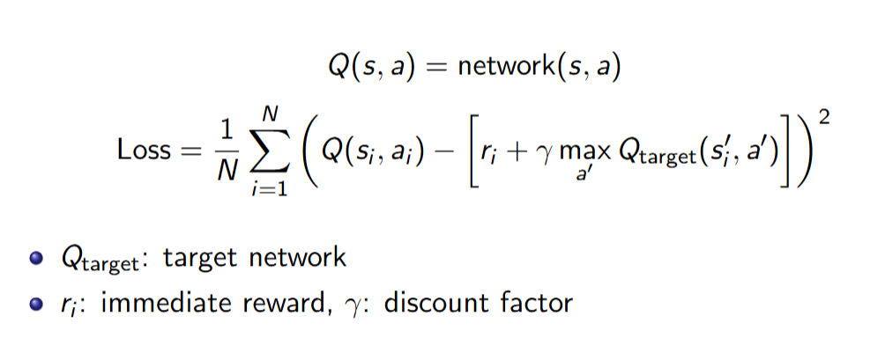

Slide 18
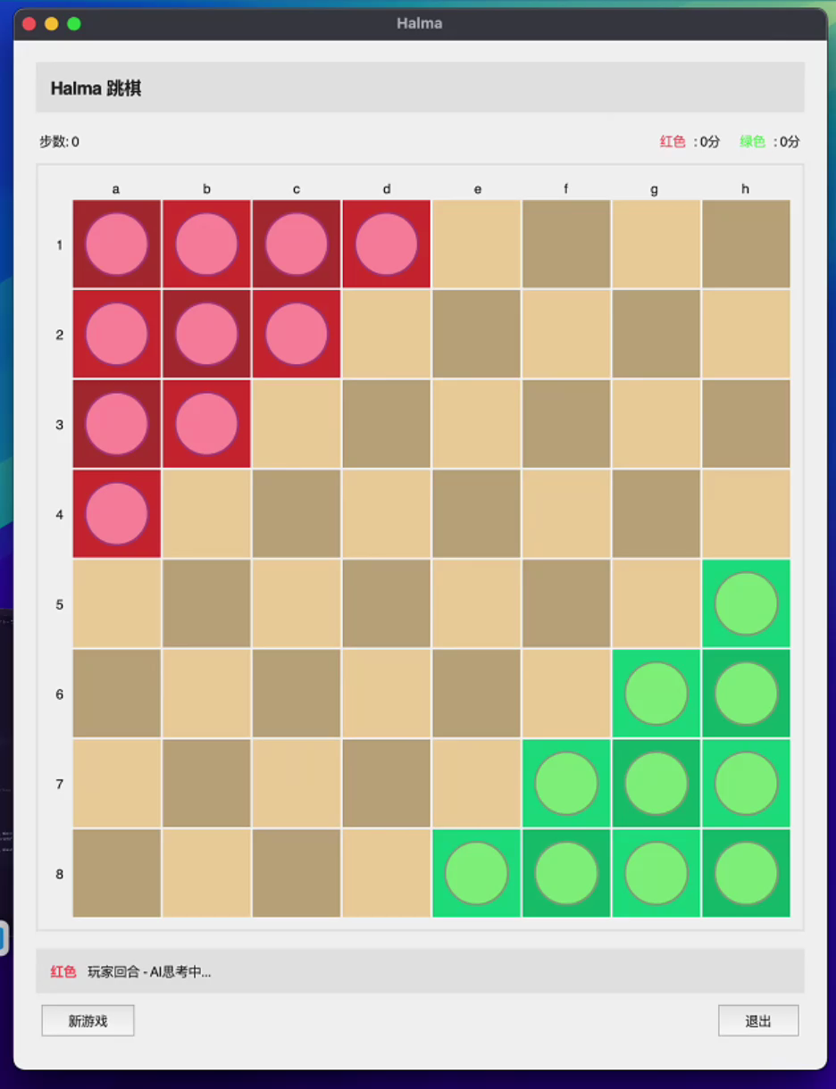
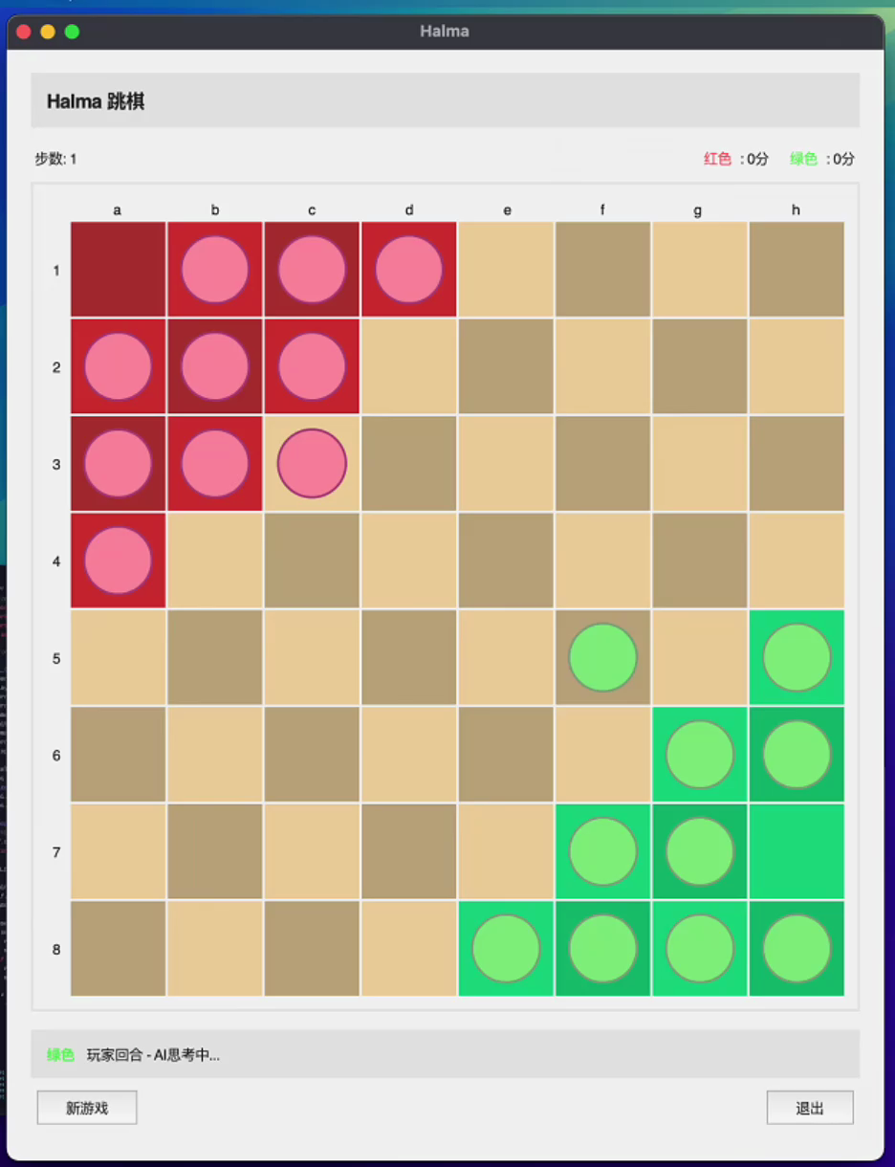
NAQL vs. Minimax
AQL vs. Greedy

Slide 19
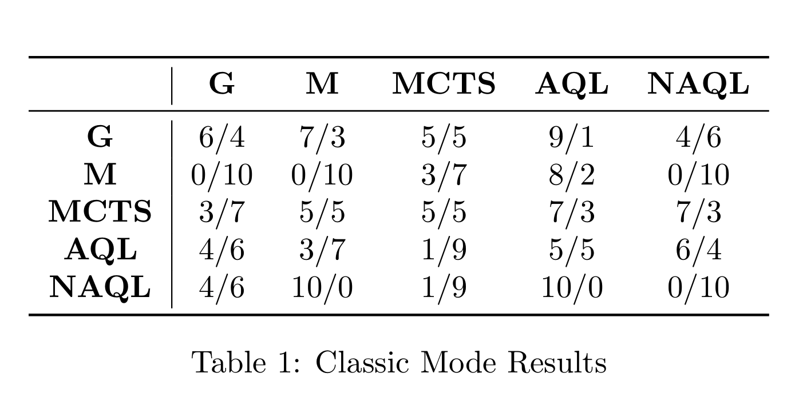
Results

Slide 20
Misc
Added Scoring Rules
Each pawn entering the goal area: +10 points
For a chain jump, score += number of consecutive jumps in the chain
All pawns in the goal area (first player): +100 points
By adjusting different jump reward, we find something interesting...

Slide 21
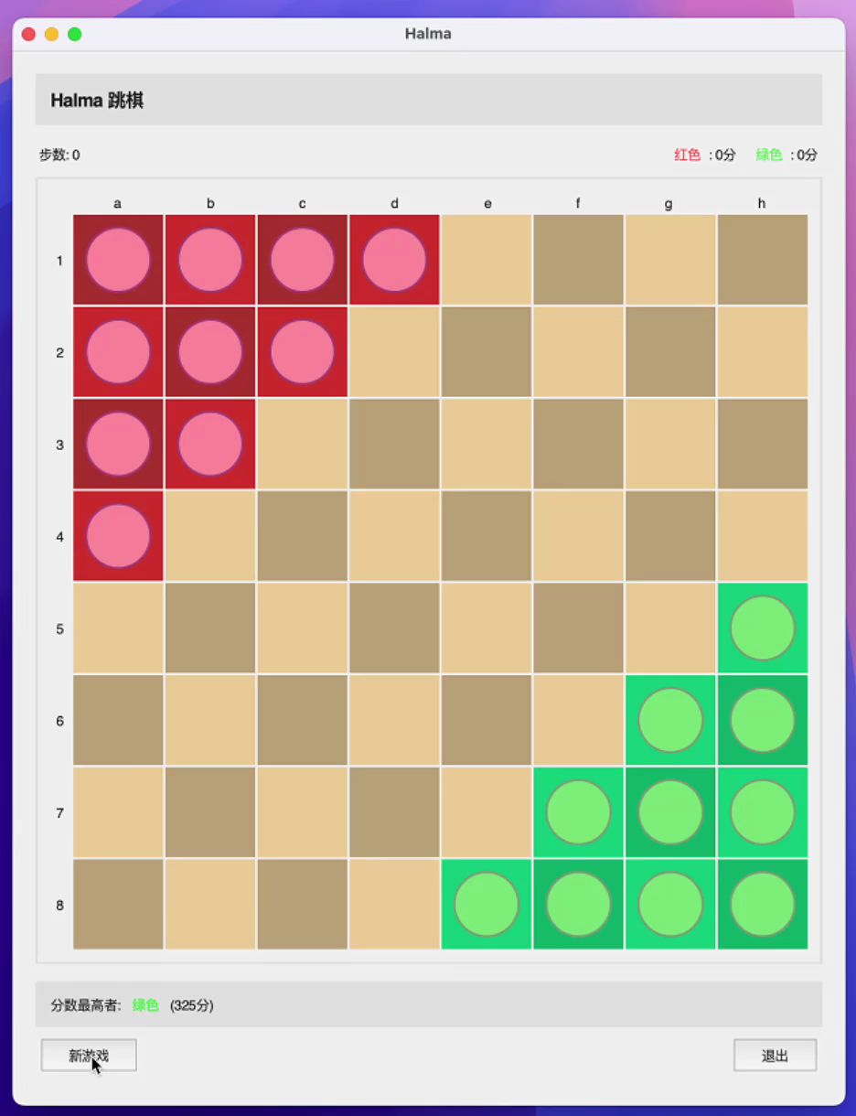
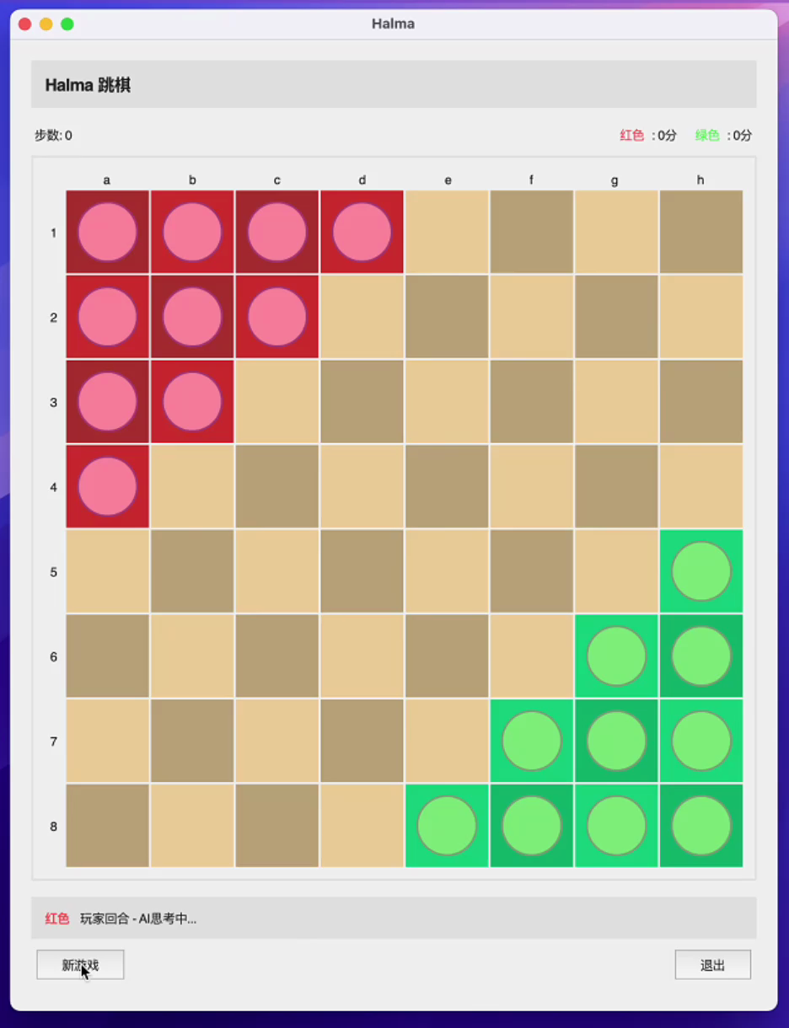
jump reward * 1
jump reward * 10

Slide 22
Thank You!

